Slide 1
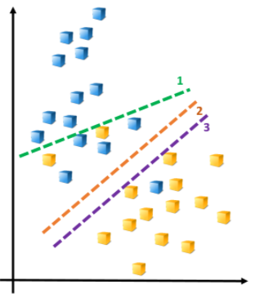
Support Vector Machines

Slide 2
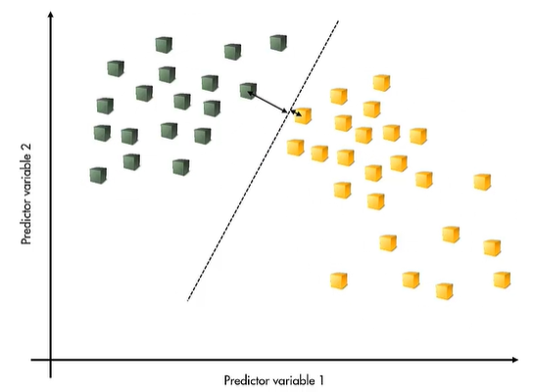
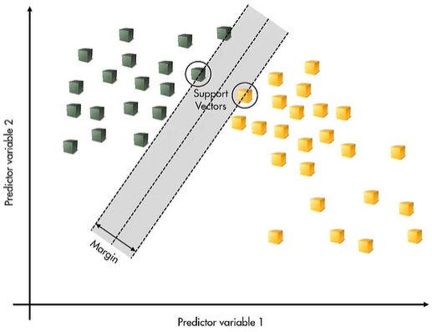
What are Support Vector Machines?
A simple way to classify observations into two classes is to draw a linear boundary between them:
Which is the best boundary?
Basic idea behind Support Vector Machines (SVM) classification:
Put the boundary as far as possible from any of the observations
The coefficients of the linear boundary are chosen to maximize the margin—that is the distance between the boundary and the nearest observations
The optimal solution is determined by the observations nearest to the boundary (support vectors)
Notes:
- Introduction to Support Vector Machines
Support Vector Machines find the best boundary between two classes (binary classification task)

Slide 3
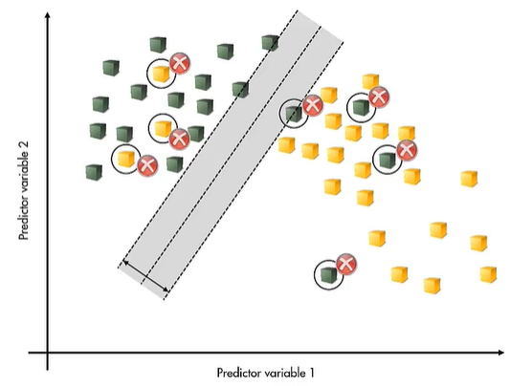
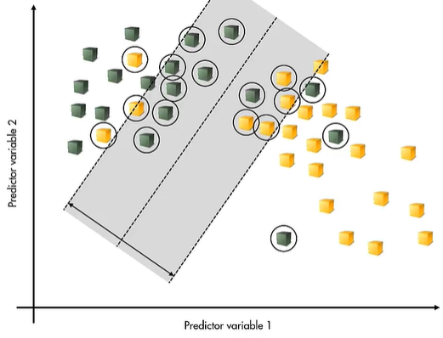
Support Vector Machines with noisy data
Real and noisy data may not be linearly separable:
There is no linear boundary that can correctly classify every observation
In this case the process is modified by maximizing the margin with a penalty term for misclassified observations
Penalty term prevents solutions having a huge margin:
Note that observations are correctly classified only if they lie on the correct side of the margin
Notes:
The margin (that is the distance between the boundary and the nearest observations) should be increased when dealing with noisy data

Slide 4
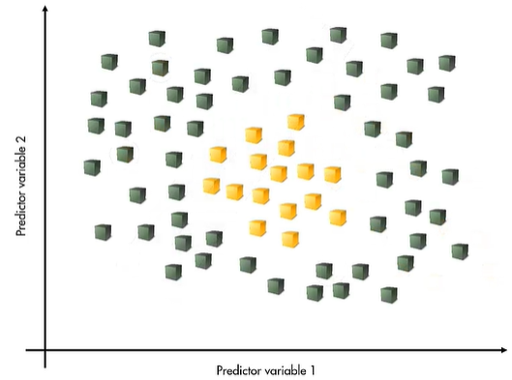

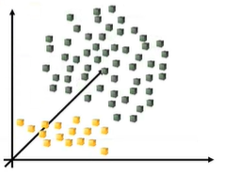
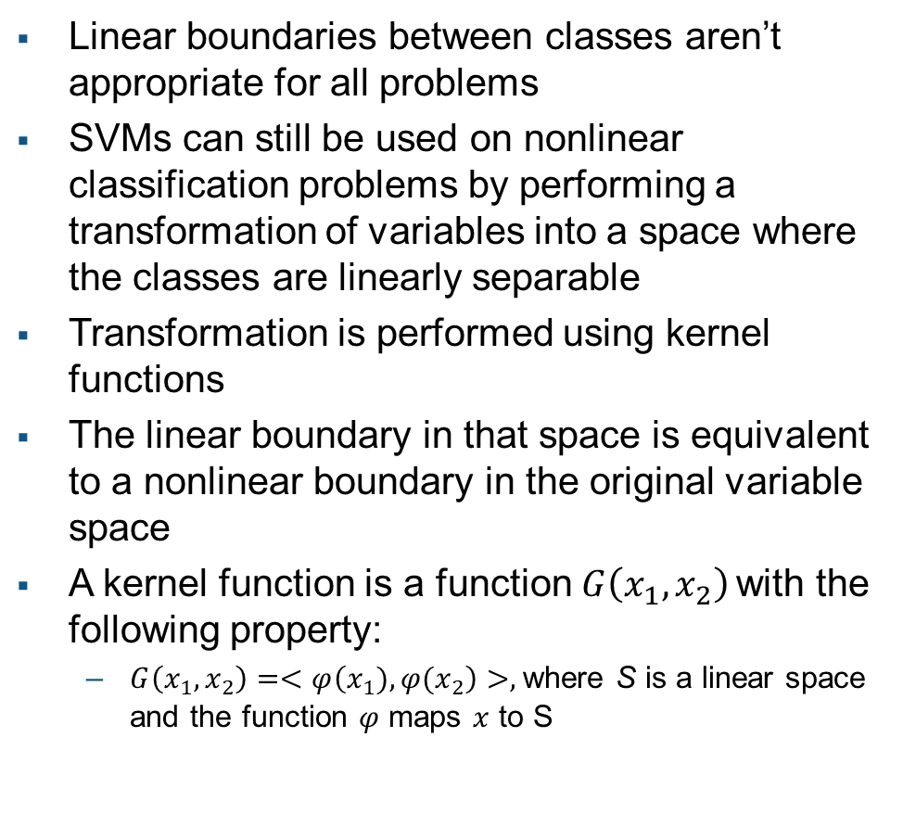
Nonlinear classification
Linear boundaries between classes aren’t appropriate for all problems
SVMs can still be used on nonlinear classification problems by performing a transformation of variables into a space where the classes are linearly separable
Transformation is performed using kernel functions
The linear boundary in that space is equivalent to a nonlinear boundary in the original variable space
A kernel function is a function $G\left({x_{1},x}_{2}\right)$ with the following property:
$G\left({x_{1},x}_{2}\right)=<φ\left({x_{1}),φ(x}_{2}\right)>,$where S is a linear space and the function $φ$ maps $x$ to S
Notes:
The kernel functions can be used to perform a nonlinear classification, performing a transformation of variables into a space where the classes are linearly separable

Slide 5
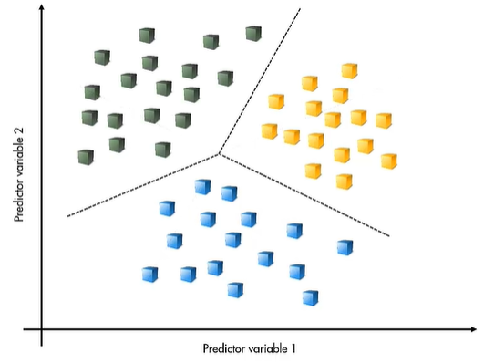
Multiclass Support Vector Machines
The SVM formulation works only for binary classification problems
Multi-class problems are solved by combining multiple binary classifiers
Notes:
Support Vector Machines can be used for multi-class problems by combining multiple binary classifiers

